Slide 1
JSP Introduction
Bernardo N. Yahya

Slide 2
Agenda
Development & Deployment Environment
Servlet overview
JSP overview
JSP Directive
JSP Scripting Elements
JSP Action

Slide 3
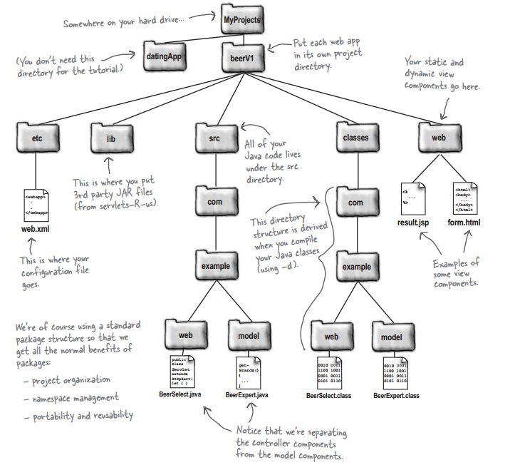
Development environment
Java library (3rd party JAR files)
Assumed to be
your project name
This is the WebContents
Java and class file

Slide 4
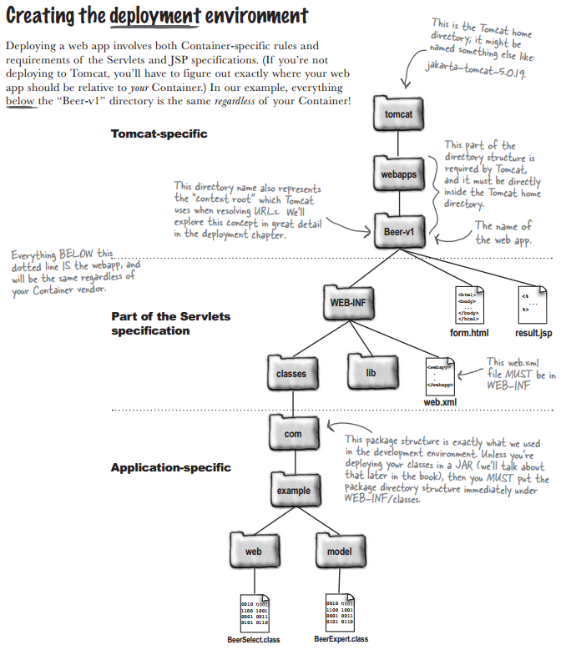
Deployment Environment
Assumed to be
your project name
HTML and JSP file
Servlet configuration
file
Only class files

Slide 5
Servlet
Servlet : Java classes that extend the functionality of a Web server by dynamically generating Web pages.
A runtime environment known as a servlet container manages servlet loading and unloading, and works with the Web server to direct requests to servlets and to send output back to Web clients.

Slide 6
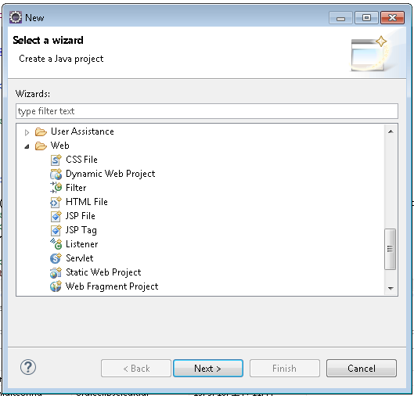
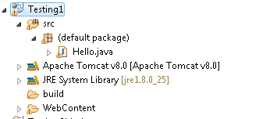
Servlet
Create Hello.java in this folder

Slide 7
Hello.java
import java.io.IOException;
import java.io.PrintWriter;
import javax.servlet.ServletException;
import javax.servlet.annotation.WebServlet;
import javax.servlet.http.HttpServlet;
import javax.servlet.http.HttpServletRequest;
import javax.servlet.http.HttpServletResponse;
/**
* Servlet implementation class Hello
*/
@WebServlet("/Hello")
public class Hello extends HttpServlet {
private static final long serialVersionUID = 1L;
private String message;
/**
* Default constructor.
*/
public Hello() {
// TODO Auto-generated constructor stub
message = "Hello World";
}
/**
* @see HttpServlet#doGet(HttpServletRequest request, HttpServletResponse response)
*/
protected void doGet(HttpServletRequest request, HttpServletResponse response) throws ServletException, IOException {
// TODO Auto-generated method stub
// Set response content type
response.setContentType("text/html");
// Actual logic goes here.
PrintWriter out = response.getWriter();
out.println("<h1>" + message + "</h1>");
}
}

Slide 8
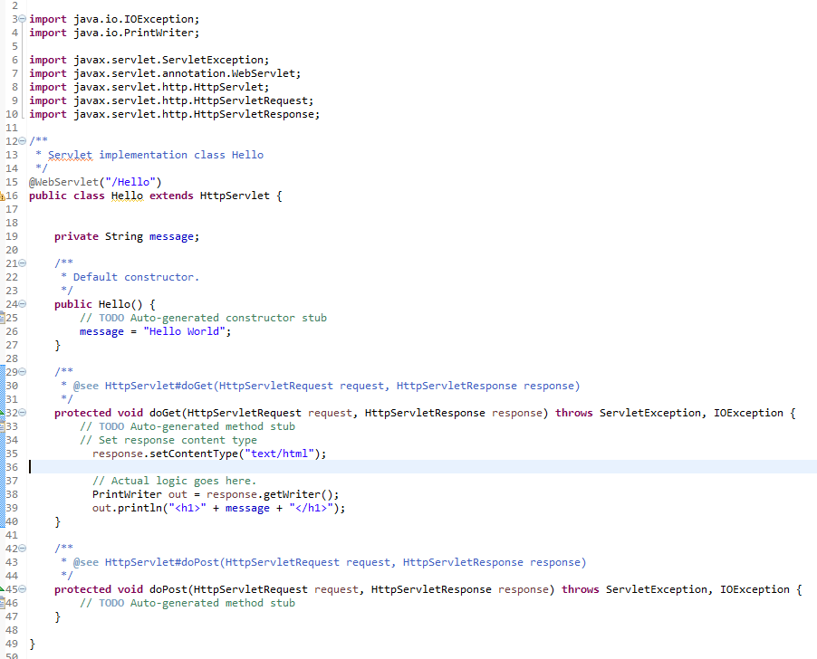
Libraries that are used in this class
Class name
Constructor
XHTML returned to the client
Constructor

Slide 9
Advantages & Disadvantages of using Servlets
Servlet Advantage
Servlets provide a way to generate dynamic documents that is both easier to write and faster to run.
provide all the powerful features of JAVA, such as Exception handling and garbage collection.
Servlet enables easy portability across Web Servers.
Servlet can communicate with different servlet and servers.
Since all web applications are stateless protocol, servlet uses its own API to maintain session
Servlet Disadvantage
Designing in servlet is difficult and slows down the application.
Writing complex business logic makes the application difficult to understand.
You need a Java Runtime Environment on the server to run servlets. CGI is a completely language independent protocol, so you can write CGIs in whatever languages you have available (including Java if you want to).

Slide 10
JSP Introduction
Java Server page (JSP) is a template for a Web page that uses Java code to generate an HTML document dynamically.
JSPs are run in a server-side component known as a JSP container, which translates them into equivalent Java servlets.
For this reason, servlets and JSP pages are intimately related.

Slide 11
Dynamic vs. Static Web Page
An Example
Static Page Dynamic Page:
<html>
<head>
<title>Document Example</title>
</head>
<body>
Hello! The time is now 16.00 Thursday, March 13th, 2014
</body>
</html>
<HTML>
<head>
<title>Document Example</title>
</head>
<BODY>
Hello! The time is now <%= new java.util.Date() %>
</BODY>
</HTML>

Slide 12
Servlets vs. JSP
JSP have more advantages than servlets:
They are automatically recompiled when necessary
Because they exist in the ordinary Web server document space, no special URL mapping is required to address them.
Because JSP pages are HTML-like, they have greater compatibility with Web development tools.

Slide 13
Servlet vs. JSP
Previous Hello.java
+
for(int i=1;i<5;i++)
{ System.out.println(i);
}
<HTML>
<head>
<title>Document Example</title>
</head>
<BODY>
<H1> Hello ! </H1>
<%= for(int i=1;i<5;i++)
{ System.out.println(i);
} %>
</BODY>
</HTML>

Slide 14
Implicit Object
There are some implicit object which container will provide to use directly in JSP these are called Implicit Object. There are 9 implicit Object in JSP
out
request
response
session
application
config
exception
pageContext
page

Slide 15
Implicit Object
These implicit objects are map to Object from Servlet/JSP API.
Implicit Object | API
out | JspWriter
request | HttpServletRequest
response | HttpServletResponse
session | HttpSession
application | ServletContext
config | ServletConfig
exception | Throwable
pageContext | PageContext
page | Object

Slide 16
How JSP works
JSP source code
Java source code
Compiled java class

Slide 17
JSP Elements
There are 3 basic JSP elements.
Directive
Scripting elements, including expressions, scriptlets, and declarations
Action

Slide 18
JSP Elements - Directive
Its a way to give instruction to Container on at page translation time. Type of Directive
page
include
taglib

Slide 19
JSP Elements - Directive
Page Directive
There might be situation where you need to import some package in JSP like you do in java file. You can use directive for this purpose.
Syntax
<%@ %>
Single package import
<%@ page import="java.lang.*" %>
Multiple package Import
<%@ page import="java.lang.*,java.lang.util.*" %>

Slide 20
JSP Elements - Directive
Attribute | Purpose
buffer | Specifies a buffering model for the output stream.
autoFlush | Controls the behavior of the servlet output buffer.
contentType | Defines the character encoding scheme.
errorPage | Defines the URL of another JSP that reports on Java unchecked runtime exceptions.
isErrorPage | Indicates if this JSP page is a URL specified by another JSP page's errorPage attribute.
extends | Specifies a superclass that the generated servlet must extend
import | Specifies a list of packages or classes for use in the JSP as the Java import statement does for Java classes.
info | Defines a string that can be accessed with the servlet's getServletInfo() method.
isThreadSafe | Defines the threading model for the generated servlet.
language | Defines the programming language used in the JSP page.
session | Specifies whether or not the JSP page participates in HTTP sessions
isELIgnored | Specifies whether or not EL expression within the JSP page will be ignored.
isScriptingEnabled | Determines if scripting elements are allowed for use.

Slide 21
JSP Elements – Directive - import
This attribute is used to import packages.
Syntax of import attribute -
<%@page import="value"%>Here value is package name.
Example of import- The following is an example of how to import more than one package using import attribute of page directive.
<%@page import="java.io.*%>
<%@page import="java.lang.*%>
<%--Comment: OR Below Statement: Both are Same--%> <%@page import="java.io.*, java.lang.*"%>
Notes:
아앙아아아아아앙ㄱ 집에가고싶아

Slide 22
Example of JSP directives
<%@ page import="java.util.*" %>
<HTML>
<BODY>
<%
System.out.println( "Evaluating date now" );
Date date = new Date();
%>
Hello! The time is now <%= date %>
Hello! The time is now
<%
out.println("<BR>" );
out.println(date);
out.println( "<BR>Your machine's address is " );
out.println( request.getRemoteHost());
%>
</BODY>
</HTML>
http://www.jsptut.com/Directives.jsp

Slide 23
JSP Elements – Directive - session
This attribute is to handle HTTP sessions for JSP pages. It can have two values: true or false. Default value for session attribute is true, which means if you do not mention this attribute, server may assume that HTTP session is required for this page.
Default value for this attribute: true
Syntax of session attribute:
<%@ page session="value"%>here value is either true OR false
Examples of session:
<%@ page session="true"%>The above code would allow a page to have session implicit objects.
<%@ page session="false"%>If this code is specified in a JSP page, it means session objects will not be available for that page. Hence session cannot be maintained for that page.

Slide 24
JSP Elements – Directive - language
It specifies the scripting language( underlying language) being used in the page.
Syntax of language:
<%@ page language="value"%>value is scripting language here.
Example of language attribute:
<%@ page language="java"%>

Slide 25
JSP Elements - Scriptlet
You might face the situation where you have to add Java code in JSP. You can use scriptlet.
A scriptlet contains Java code that is executed every time the JSP is invoked.
For example:
<% system.out.println("Hello"); %>

Slide 26
JSP Elements - Expression
Expression is used when you want to provide some argument to statement that prints to the implicit response PrintWriter out. Expression becomes the argument to an out.print().
Syntax
Method parameter
<%= contact.getName()%>
variable access
<%= x %>
Note: If there are local variable as well as instance variable then above statement will print the value of local variable if you want to print the instance variable then use this like below.
<%= this.x %>
Here contact.getName will be provided as the argument to out implicit object as it is.
Note: DO not place ”;” in the end of expression.

Slide 27
JSP Elements - Declaration
JSP declaration defined inside the class but outside the service method. It means declaration is for static and instance variable and methods.
Syntax
Variable declaration
<%! int i=0;%>
Method Declaration
<%! String getName() {
String name = "JBT";
return name; } %>
Note: Here we are using ”;” in the end as it be statement in generated java file. So it is required.

Slide 28
Example 1 (combination with html)
Directive - language
<%@ page language="java" contentType="text/html; charset=EUC-KR"
pageEncoding="EUC-KR"%>
<!DOCTYPE html PUBLIC "-//W3C//DTD HTML 4.01 Transitional//EN" "http://www.w3.org/TR/html4/loose.dtd">
<html>
<head>
<meta http-equiv="Content-Type" content="text/html; charset=EUC-KR">
<title>Testing JSP Elements with for loop</title>
</head>
<BODY>
<TABLE BORDER=2>
<%
int n = 10;
boolean even = true;
for ( int i = 0; i < n; i++ ) {
%>
<TR>
<TD>Number</TD>
<TD><%= i+1 %></TD>
<%
if(((i+1)%2==0))
even=true;
else
even = false;
%>
<TD><% if (even)
{
%>
<p>Even</p> <%
} else
{%>
<p>Odd</p>
</TR>
<%}
System.out.println("Testing "+(i+1));
}
%>
</TABLE>
<%out.println("<BR> End of Testing"); %>
</BODY>
</html>
Declaration
Expression
Scriptlet

Slide 29
Example 2 (combination with html)
Directive - language
<%@ page language="java" contentType="text/html; charset=EUC-KR"
pageEncoding="EUC-KR"%>
<!DOCTYPE html PUBLIC "-//W3C//DTD HTML 4.01 Transitional//EN" "http://www.w3.org/TR/html4/loose.dtd">
<%! int fontSize; %>
<html>
<head>
<meta http-equiv="Content-Type" content="text/html; charset=EUC-KR">
<title>Testing JSP Elements with While Loop</title>
</head>
<BODY>
<%while ( fontSize <= 3){ %>
<font color="green" size="<%= fontSize %>">
JSP Tutorial
</font><br />
<%fontSize++;%>
<%}%>
<% out.println("-- Variable Declaration---"); %>
<% out.println();%>
<%! String name="Bernardo"; %>
<%! int age=20; %>
<%= "Name is: "+ name %><br>
<%= "AGE: "+ age %>
<% out.println("-- Method Declaration---"); %>
<% out.println();%>
<%!
int sum(int num1, int num2, int num3){
return num1+num2+num3;
}
%>
<
<%= "Result is: " + sum(10,40,50) %>
</BODY>
</html>
While Loop
Variable
Declaration
Scriptlet
Method
Declaration

Slide 30
JSP comments
You can put comments in JSP and there are two type of comments in JSP.
HTML Comment
These comment will be the part of generated response means these comment will go to client side. Syntax:
<!-- Comment -->
JSP Comment
These comments are for the developer only it will not be the part of translated page. Syntax:
<%-- Comment --%>

Slide 31
JSP Action
JSP actions use constructs in XML syntax to control the behavior of the servlet engine. You can dynamically insert a file, reuse JavaBeans components, forward the user to another page, or generate HTML for the Java plugin.
There is only one syntax for the Action element, as it conforms to the XML standard:
<jsp:action_name attribute="value" />

Slide 32
JSP Action
Syntax | Purpose
jsp:include | Includes a file at the time the page is requested
jsp:useBean | Finds or instantiates a JavaBean
jsp:setProperty | Sets the property of a JavaBean
jsp:getProperty | Inserts the property of a JavaBean into the output
jsp:forward | Forwards the requester to a new page
jsp:plugin | Generates browser-specific code that makes an OBJECT or EMBED tag for the Java plugin
jsp:element | Defines XML elements dynamically.
jsp:attribute | Defines dynamically defined XML element's attribute.
jsp:body | Defines dynamically defined XML element's body.
jsp:text | Use to write template text in JSP pages and documents.

Slide 33
The <jsp:include> Action
This action lets you insert files into the page being generated. The syntax looks like this:
<jsp:include page="relative URL" flush="true" />
Unlike the include directive, which inserts the file at the time the JSP page is translated into a servlet, this action inserts the file at the time the page is requested.
Following is the list of attributes associated with include action:
Attribute | Description
page | The relative URL of the page to be included.
flush | The boolean attribute determines whether the included resource has its buffer flushed before it is included.

Slide 34
Example
First example, one jsp file and one html file.
Let’s have two jsp files
main.jsp
date.jsp
Second Example
include_ex.jsp
copyright.jsp

Slide 35
JSP Elements (@include)
flavors.jsp
flavor_list.html
<body>
<h3> Flavors</h3>
our popular flavors are:
<%@ include file="flavor_list.html" %>
Try them all
</body>
<body>
<ol>
<li> Choco</li>
<li> Strawberry</li>
<li> Vanilla </li>
</ol>
</body>

Slide 36
JSP Elements (@include)
Assume that you write flavors.jsp in a folder named “course”. To include index.jsp which is located at the root, you can do as follows:
If the name begins with “/”, it refers to a path beginning at the top of the context; otherwise, it is interpreted as a path relative to the directory containing the calling jsp.
<body>
<h3> Flavors</h3>
our popular flavors are:
<%@ include file="flavor_list.html" %>
<%@ include file="/index.jsp" %>
Try them all
</body>

Slide 37
JSP Elements (@include)
main.jsp
date.jsp
<html>
<head>
<title>The include Action Example</title>
</head>
<body>
<center>
<h2>The include action Example</h2>
<jsp:include page="date.jsp" flush="true" />
</center>
</body>
</html>
<p>
Today's date: <%= (new java.util.Date()).toLocaleString()%>
</p>

Slide 38
JSP Elements (@include)
include_ex.jsp
copyright.jsp
<html>
<head><TITLE>Include Test</TITLE></head>
<body>
<table width=800>
<tr>
<td>
This page to show the example of INCLUDE
</td>
</tr>
</table><br>
<hr>
<br>
<%@ include file="copyright.jsp" %>
</body>
</html>
<div align="center">
<font size="-1" face="돋움">
&copy; 1995-2014 by Industrial & Management Engineering (IME). All rights reserved.<br>
For any inquiries, please contact IME departments </font>
<a href=mailto:abc@hufs.ac.kr>
<img src="letter.gif" WIDTH="14" HEIGHT="11" border="0"></a>
<br>
<a href="http://ie.hufs.ac.kr/">[HOME]</a>&nbsp;
<a href="include_ex.jsp">[Main]</a>
<br><br><br>
</div>

Slide 39
The <jsp:forward> Action
The forward action terminates the action of the current page and forwards the request to another resource such as a static page, another JSP page, or a Java Servlet.
The simple syntax of this action is as follows:
<jsp:forward page="Relative URL" />

Slide 40
JSP elements (@forward)
main.jsp
date.jsp
<html>
<head>
<title>The include Action Example</title>
</head>
<body>
<center>
<h2>The forward action Example</h2>
<jsp:forward page="date.jsp"/>
</center>
</body>
</html>
<p>
Today's date: <%= (new java.util.Date()).toLocaleString()%>
</p>

Slide 41
Practice
Input 10
Output : print two columns with detail as follows:
First column contains a number from 1 to 10
Second column contains the square of its number.

Slide 42
References
[1]. http://javabeginnerstutorial.com/servlet-2/servlet-basics/
[2] http://beginnersbook.com/2013/05/jsp-tutorial-directives/

